Slide 1


Summer Internship Progress Report
Welcome to my progress report. This presentation will cover the key tasks and achievements during my summer internship as a PMO Intern, working under Deepak Batra Sir.
by Rajkumar Insurance

Slide 2




Collaborative Departmental Engagements
Admin Team
Coordinated with administrative staff.
Various Departments
Engaged across multiple business units.
Excel Tasks
Successfully completed various Excel-based assignments.

Slide 3
Optimizing Atwork Seating Management
Task Overview
Data Collection
Managed Atwork seating data.
Gathered comprehensive seating information.
Ensured efficient space utilization.
Contributed to office organization.
Layout Planning
Assisted in optimizing seating arrangements.

Slide 4
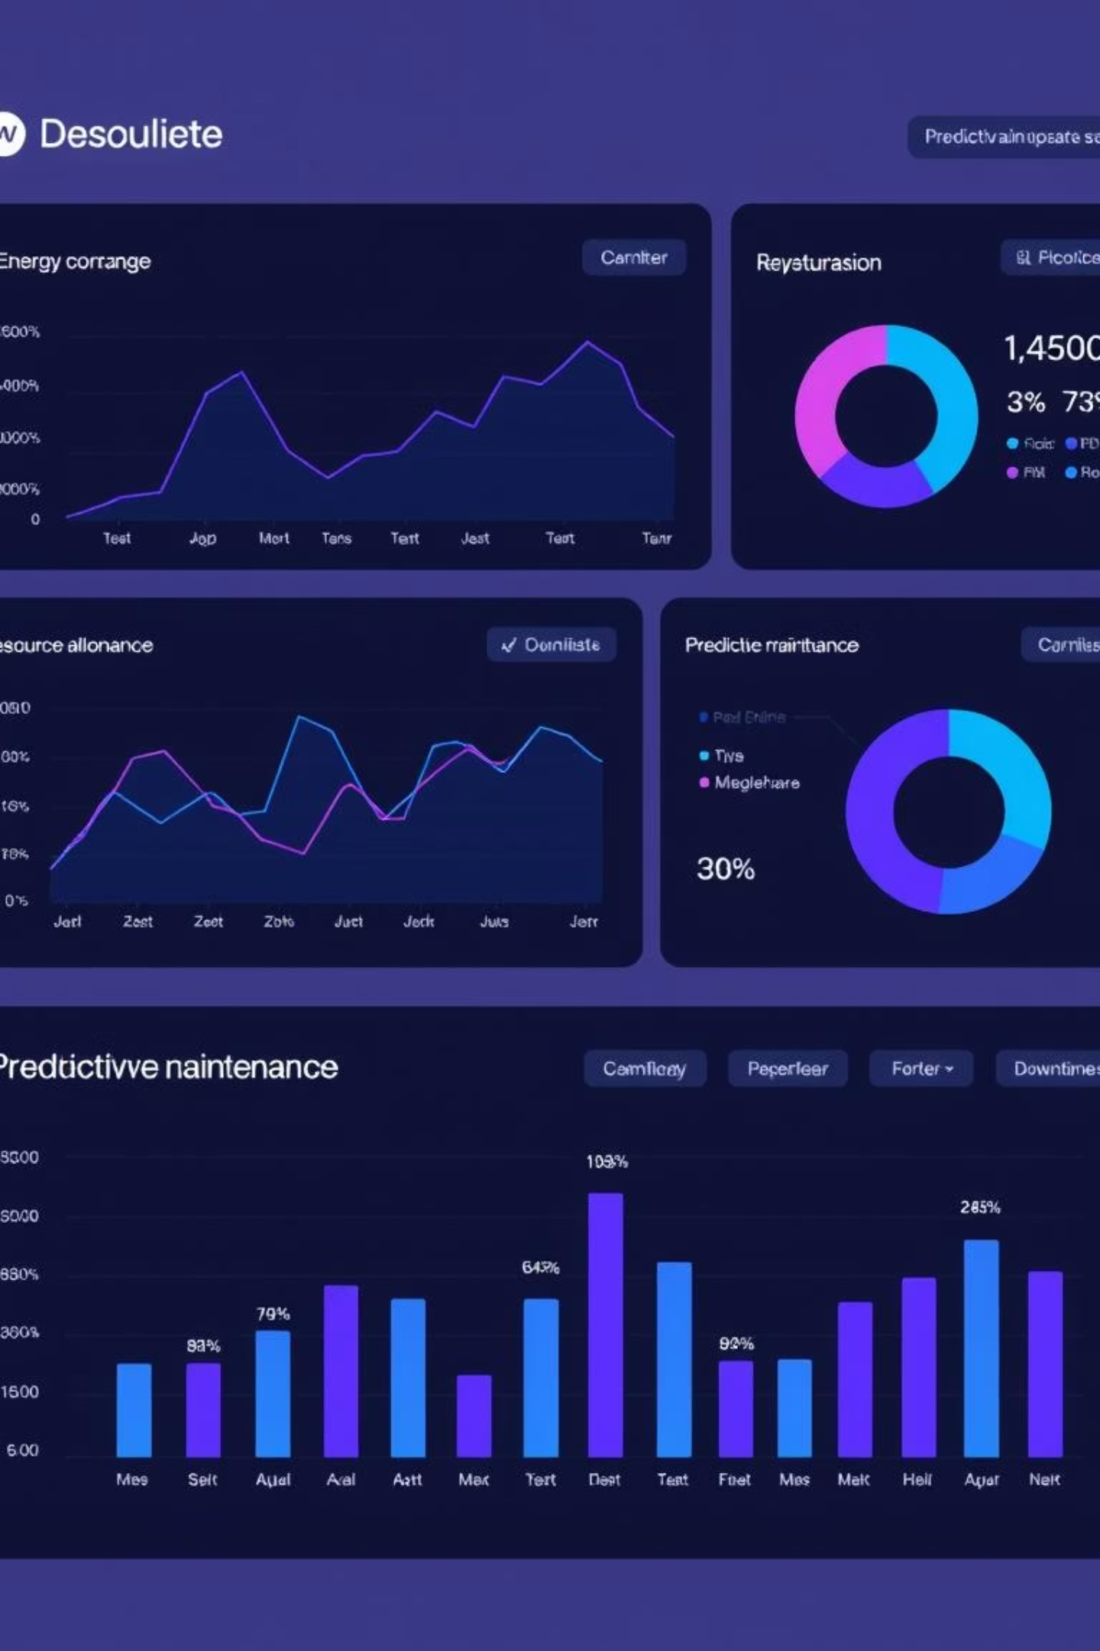
GCC Planner Development for Strategic Oversight
1
GCC Dashboard Creation
Developed for CEO insights.
2
Assignment Tracking
Monitored ongoing projects.
3
Progress Monitoring
Tracked project advancement.
4
Project Collaboration
Worked closely with project teams.

Slide 5


Enhancing ELCM Data Integration
ELCM Data Mapping
Integrated ELCM with Atwork and CH6 seating.
Headcount Analysis
Provided total headcount by department.
Categorized hires and internal movements.
Location Breakdown
Department-wise data across locations.

Slide 6
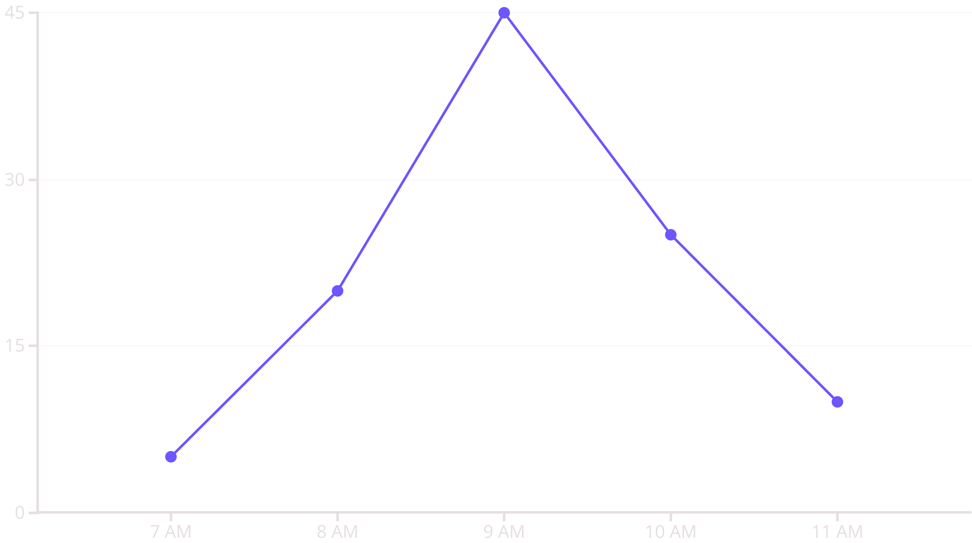
Analyzing Employee Occupancy Patterns
Python-powered analysis revealed peak entry times and occupancy patterns of employees assigned to Atwork building seats.

Slide 7




Key Achievements and Skill Development
1
Data Insights
2
System Integration
3
Python Automation
4
Cross-functional Collaboration
This internship significantly enhanced my analytical, technical, and collaborative skills, preparing me for future challenges.

Slide 8


Conclusion and Future Outlook
Key Takeaways
Next Steps
Valuable hands-on PMO experience.
Apply learned skills in future roles.
Improved data analysis capabilities.
Explore advanced project management.
Strengthened inter-departmental communication.
Contribute to organizational efficiency.

